Slide 1
Database faculty of computers science and information
Database contains table for students and table for Adminstrators and table for employee and table for subjects and table for department of the faculty

Slide 2
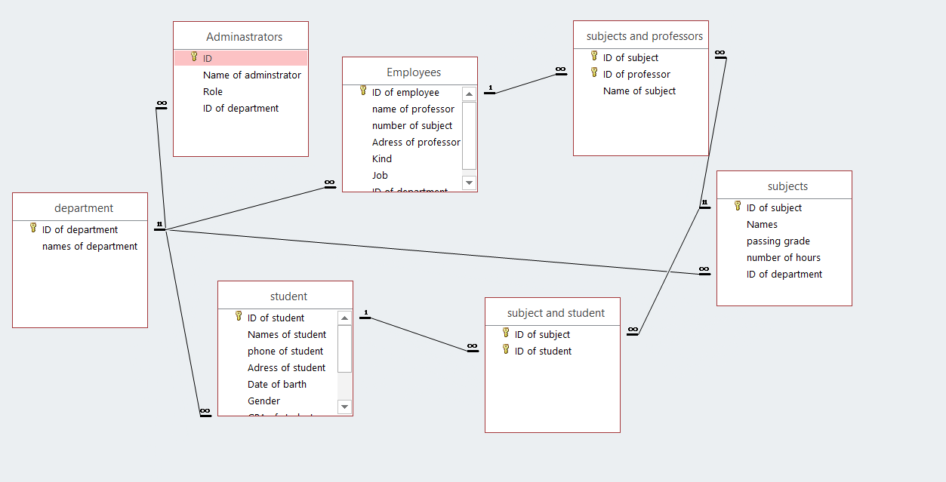
Relations

Slide 3
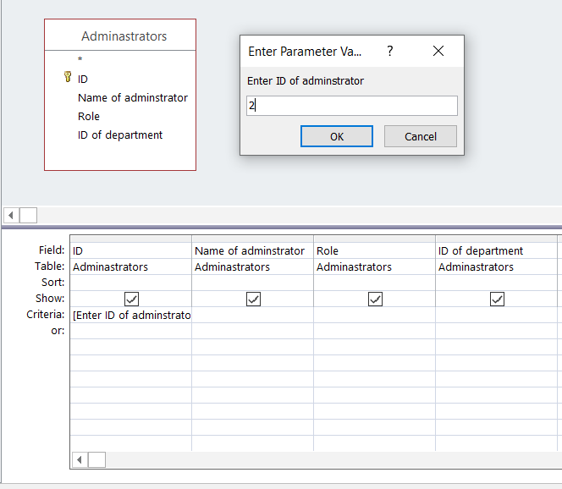

Query for adminstrators

Slide 4
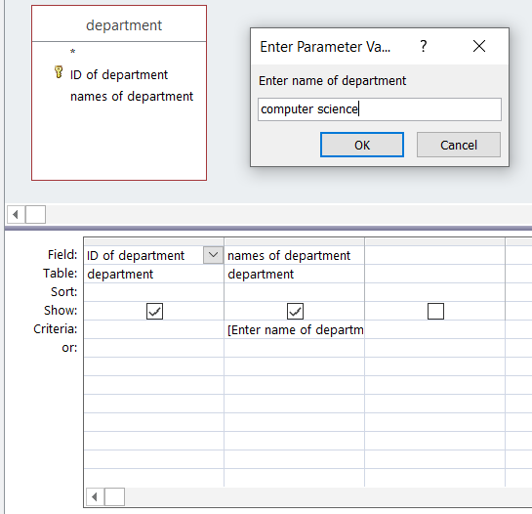

Query of department

Slide 5
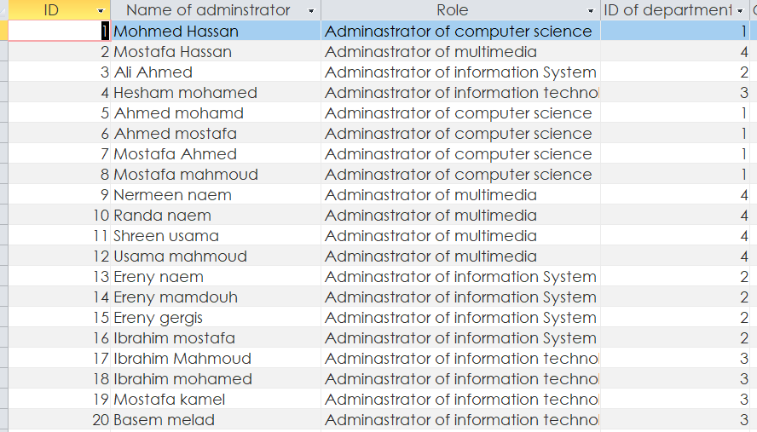

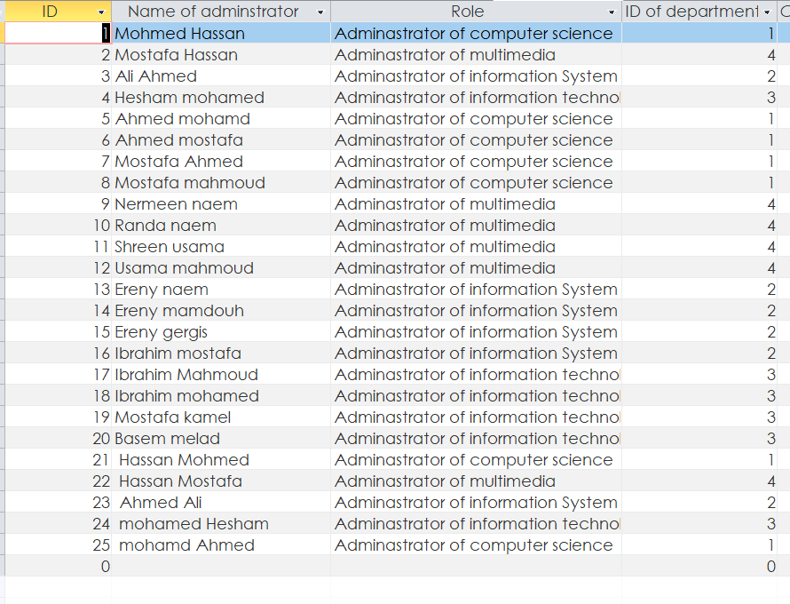
Query of append of adminstrators

Slide 6
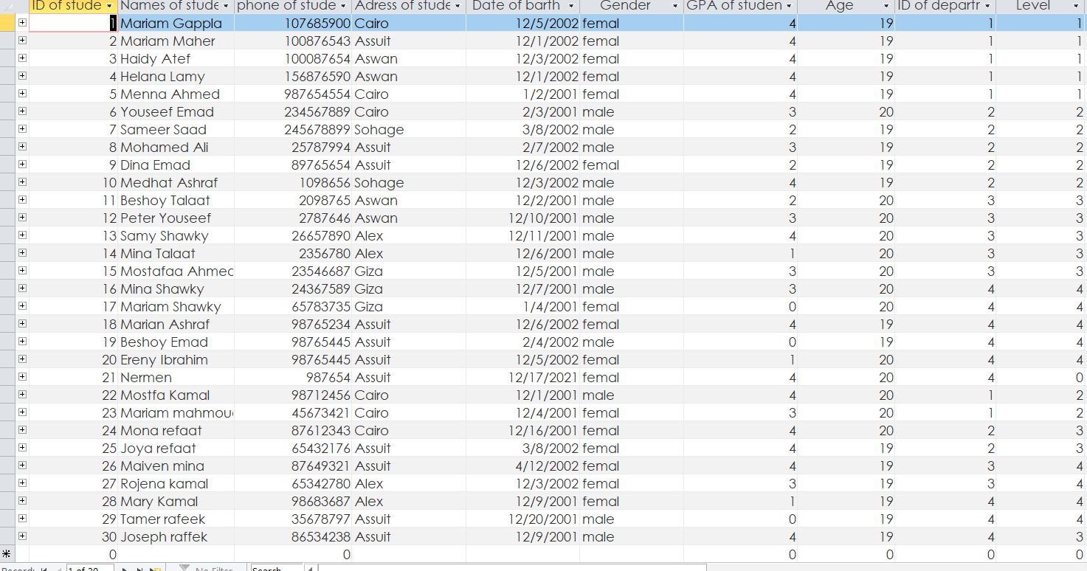
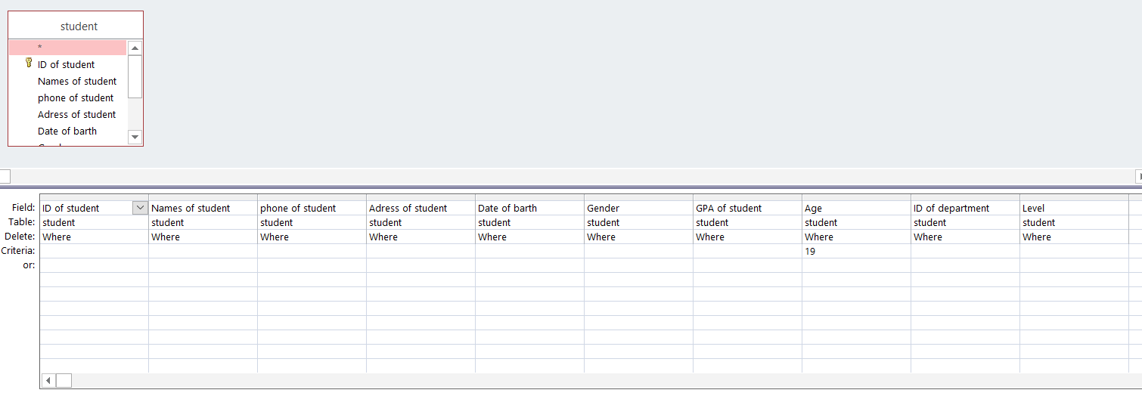
Quary for delete some student

Slide 7

Result for delete some student

Slide 8
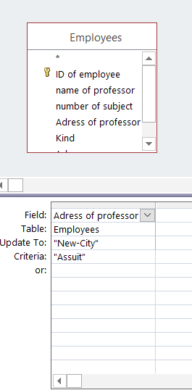
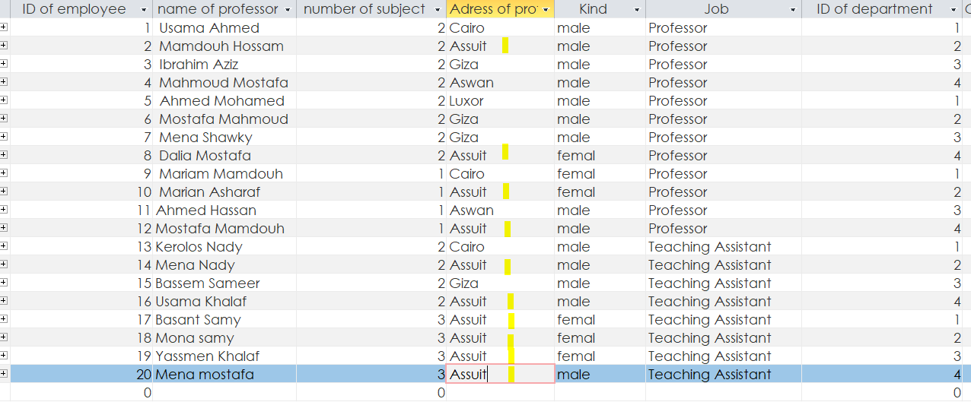
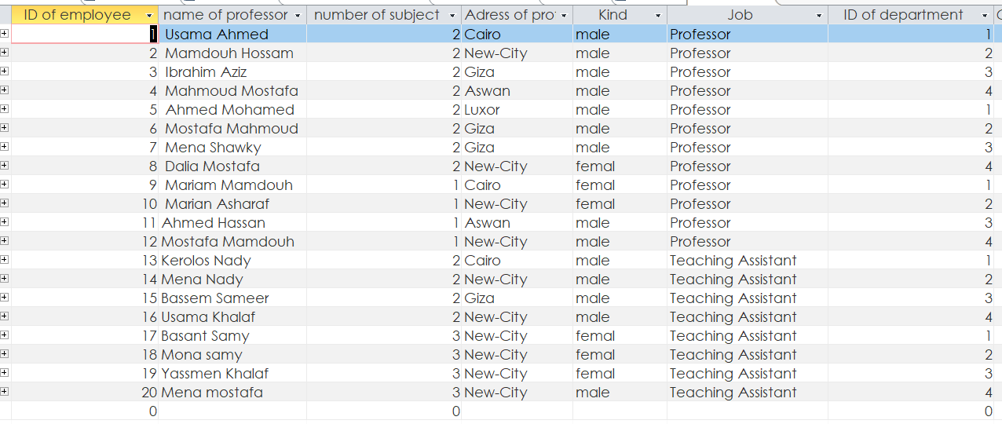
Query for update employee

Slide 9
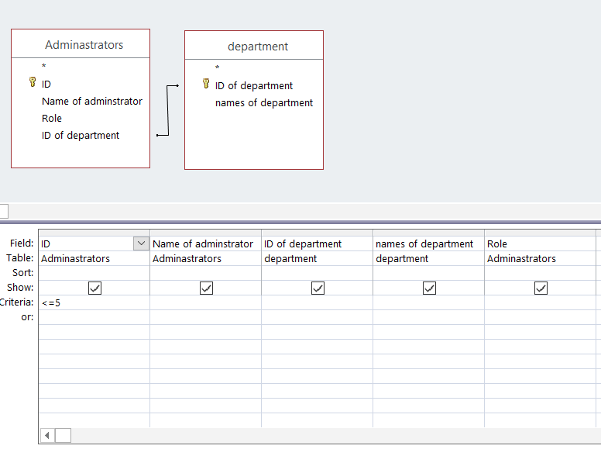

Query for make table between Adminstrator and department

Slide 10
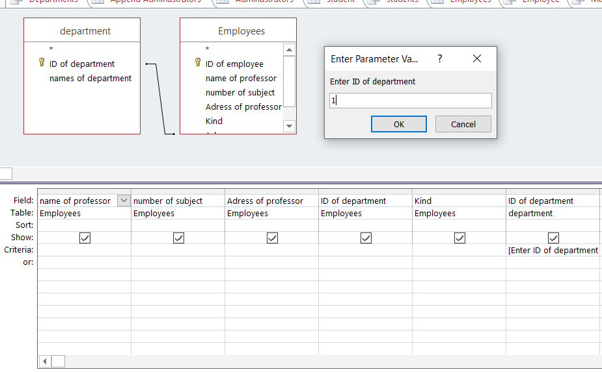

Query for department and emplyees

Slide 11
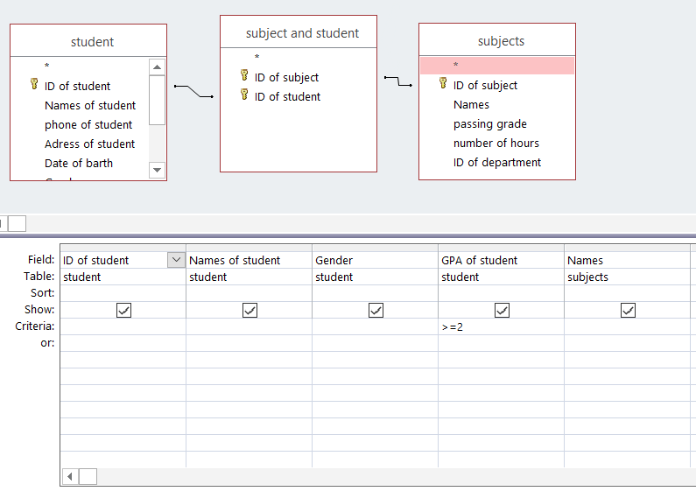
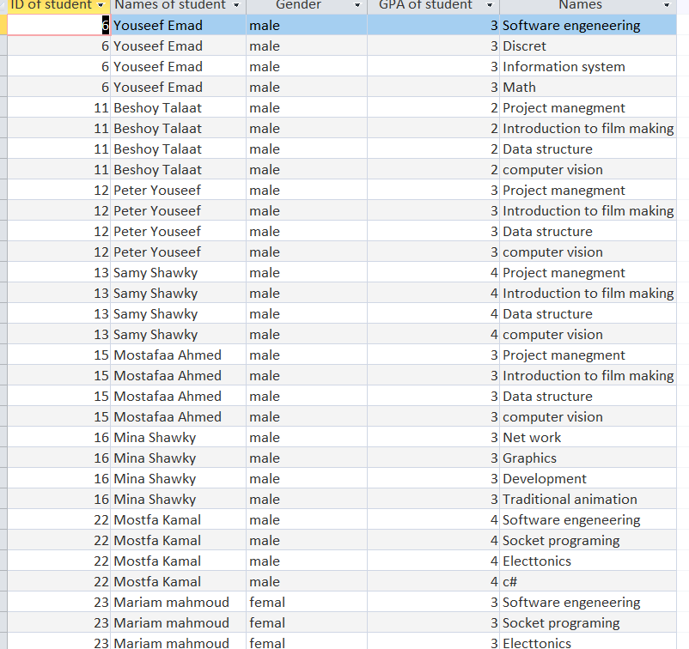
Query for students and subjects(Students are passing)

Slide 12
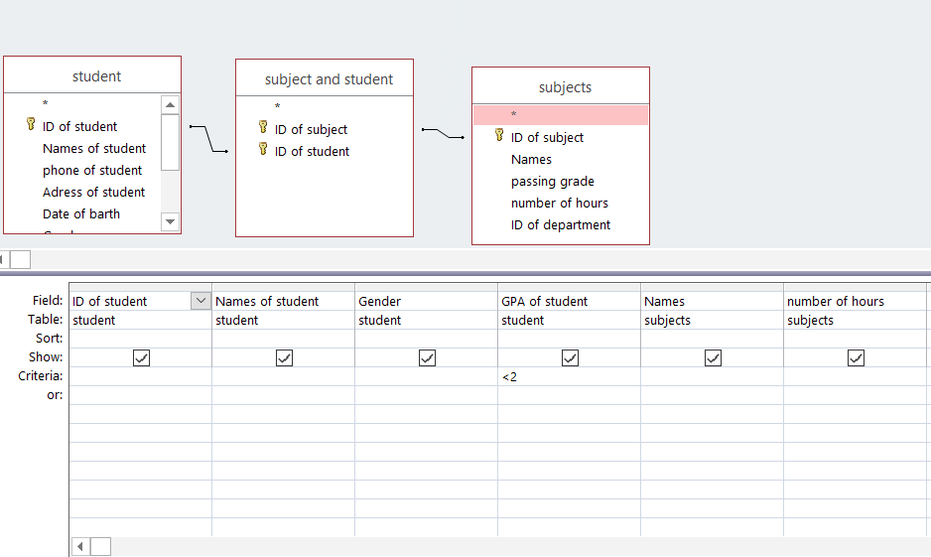

Query for students and subjects(Students are failing)

Slide 13
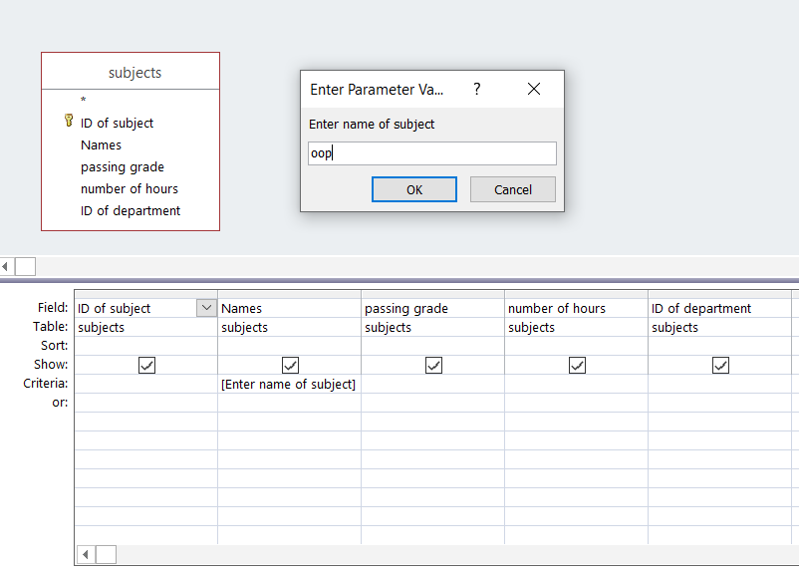
Query for subject

Slide 14
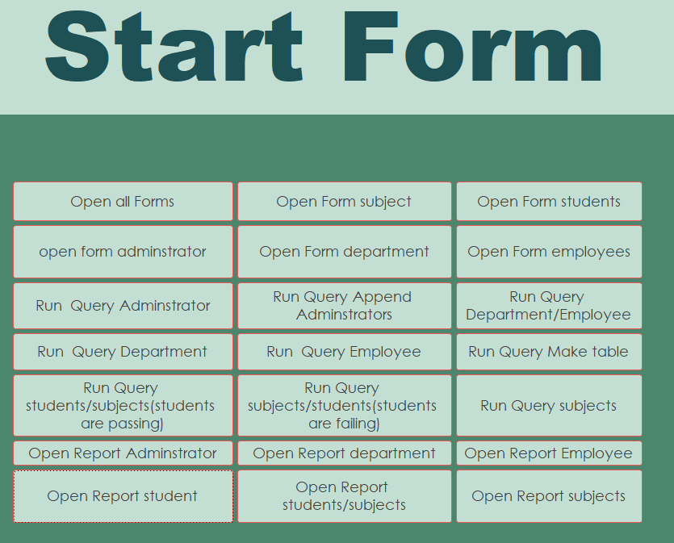
Start form

Slide 15
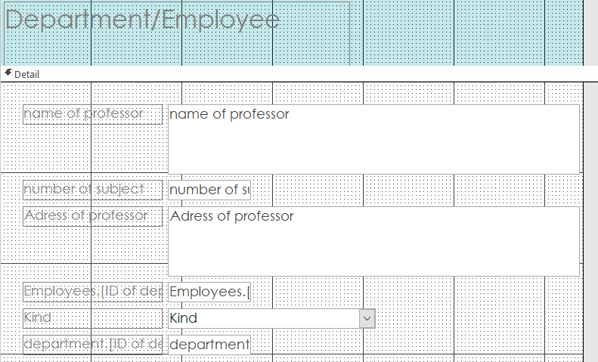
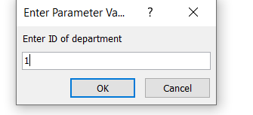
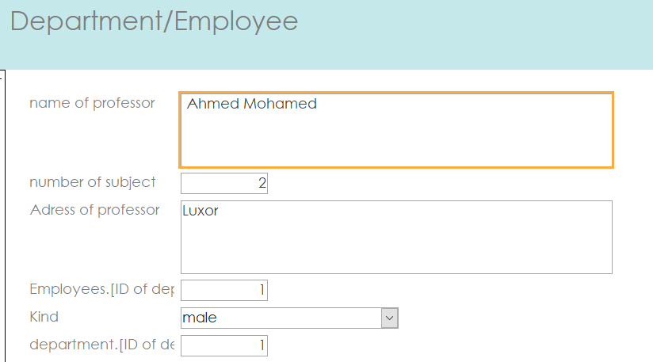
Form for query Department/Employee

Slide 16
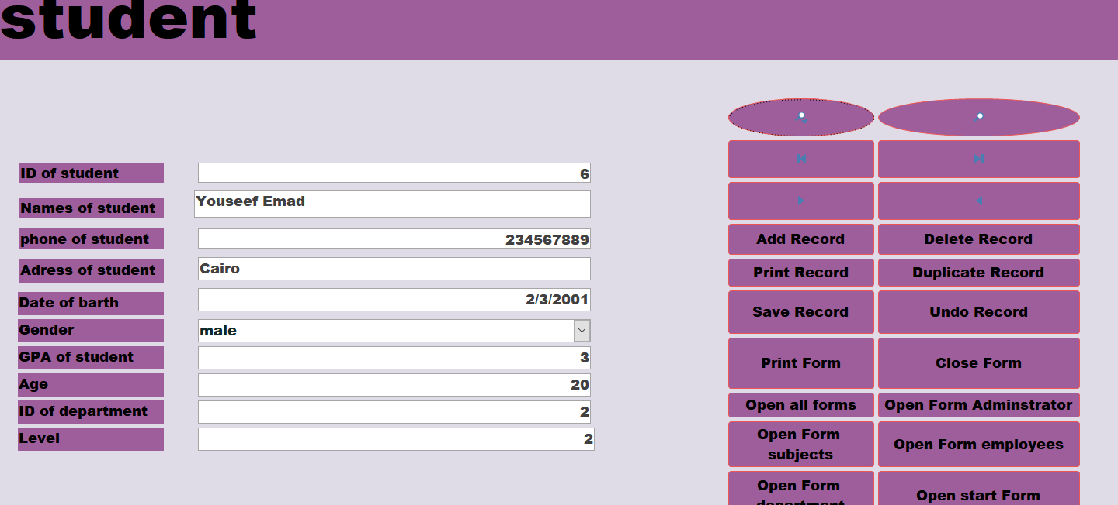
Form for students

Slide 17
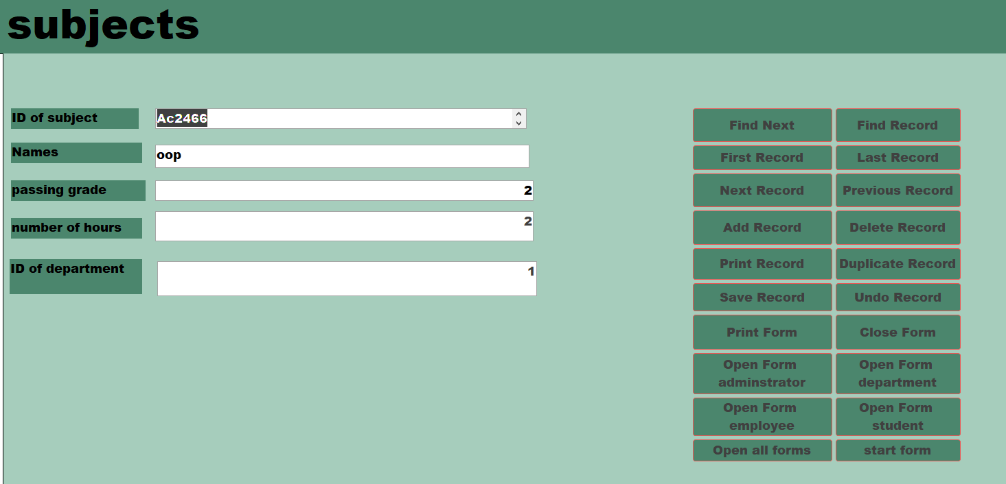
Form for subjects

Slide 18
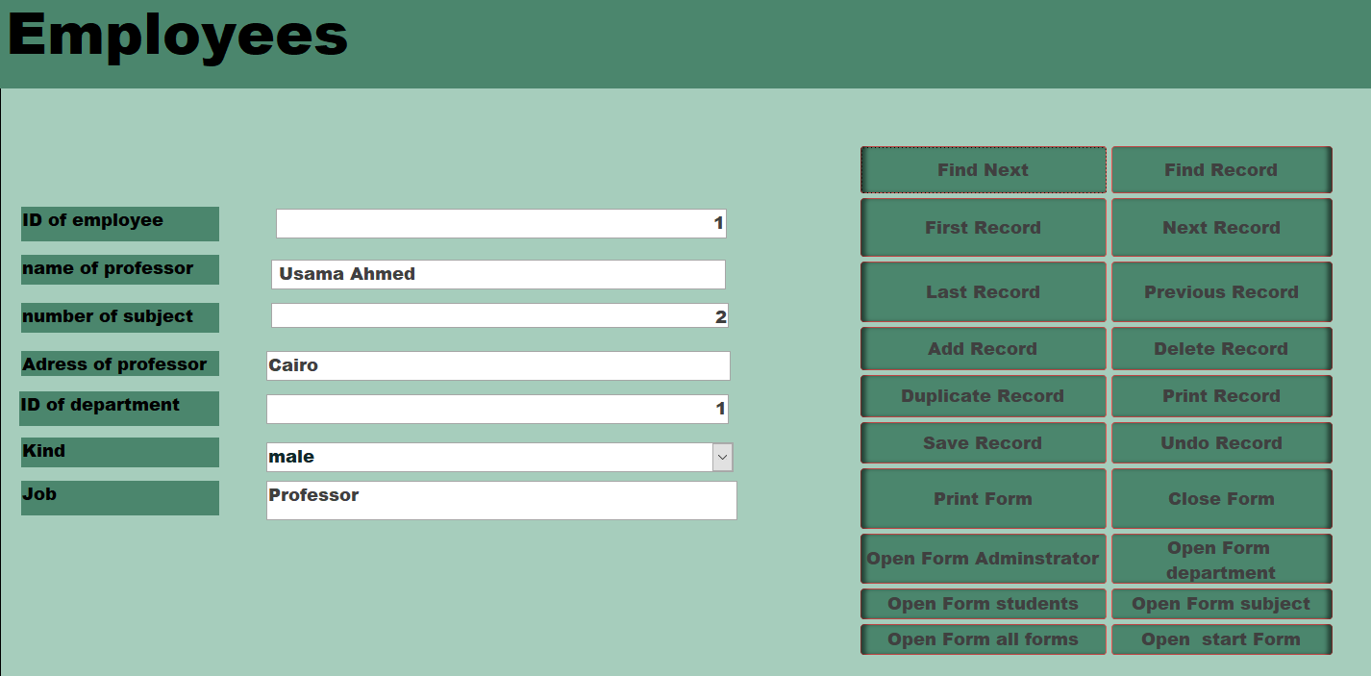
Form for employees

Slide 19
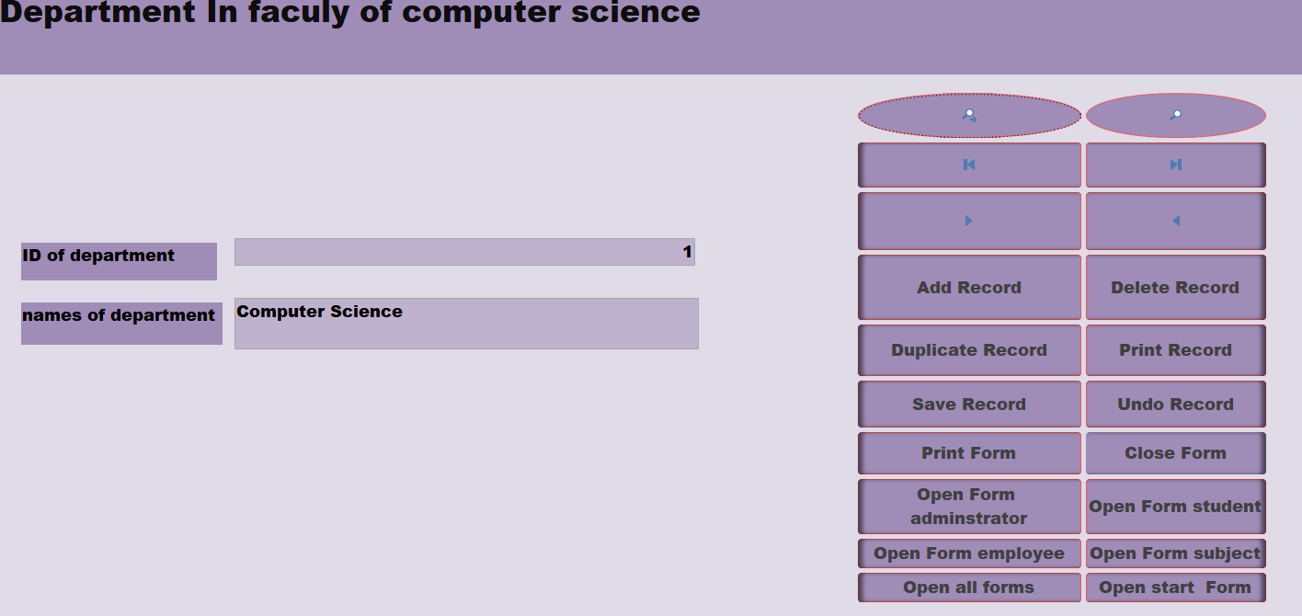
Form for departments

Slide 20
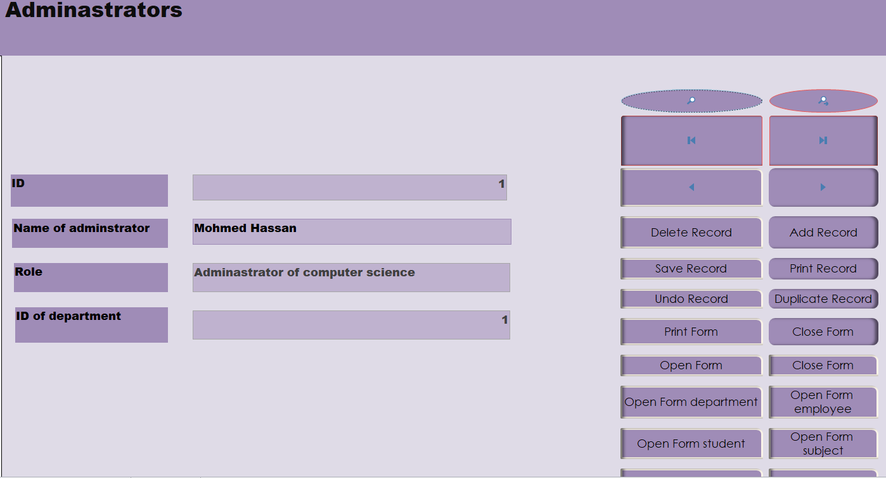
Form for Adminstrators

Slide 21
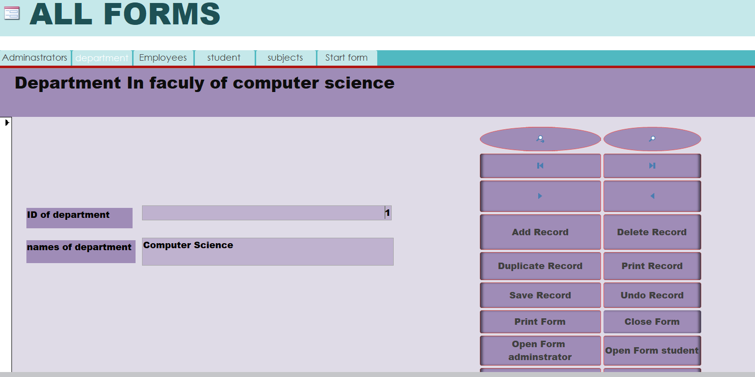
Navigation Form

Slide 22
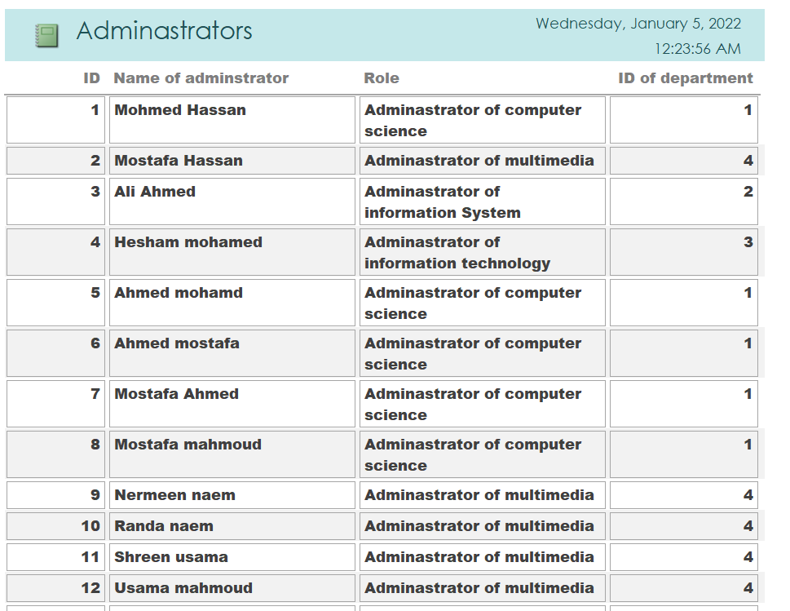
Report for Adminstrators

Slide 23
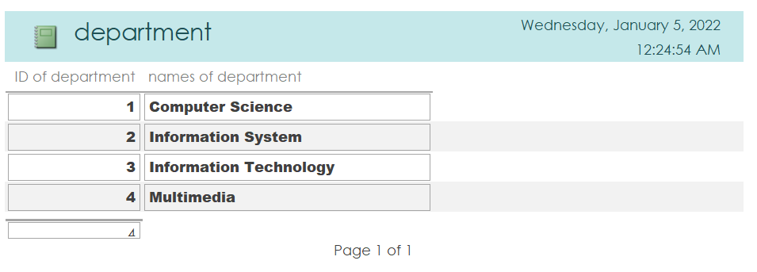
Report for Departments

Slide 24
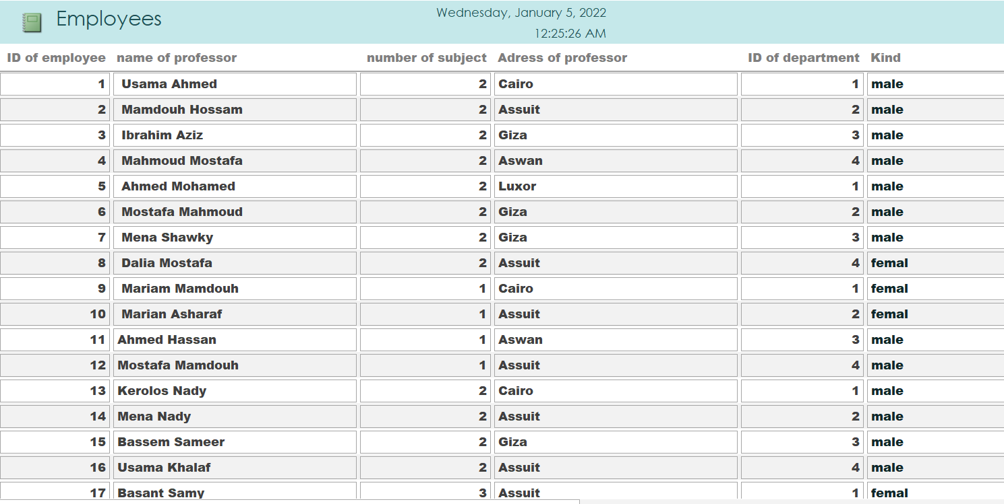
Report for employees

Slide 25
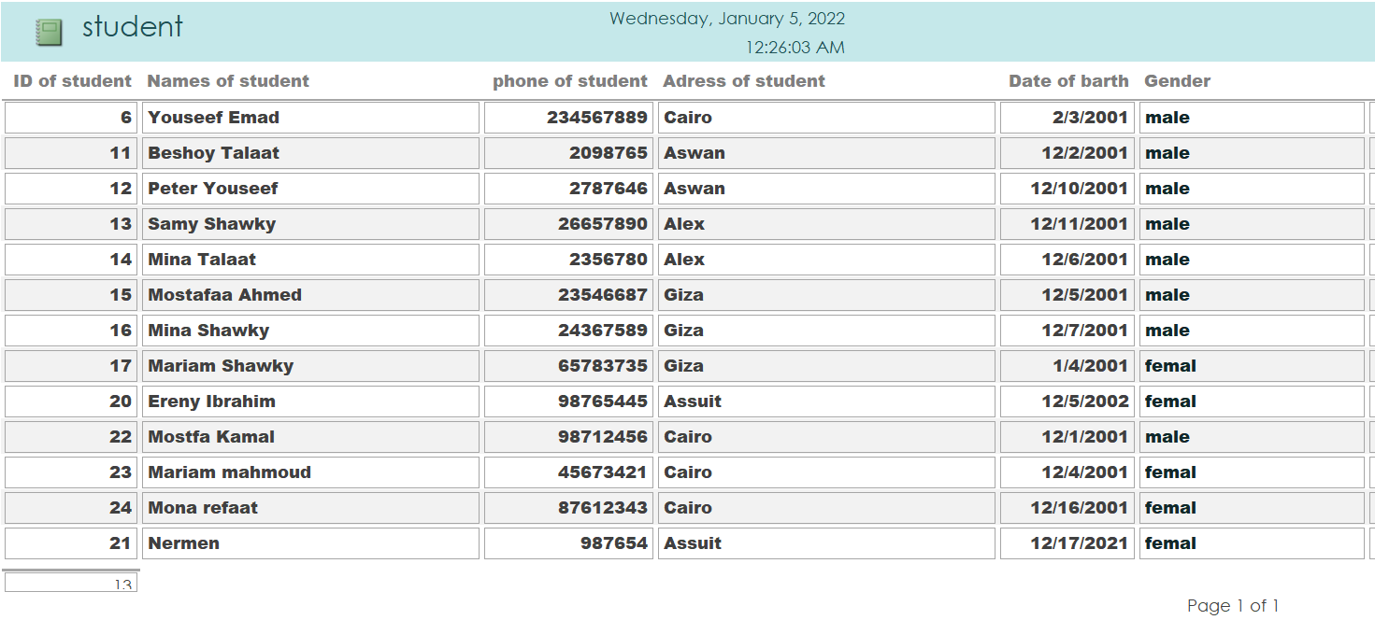
Report for students

Slide 26
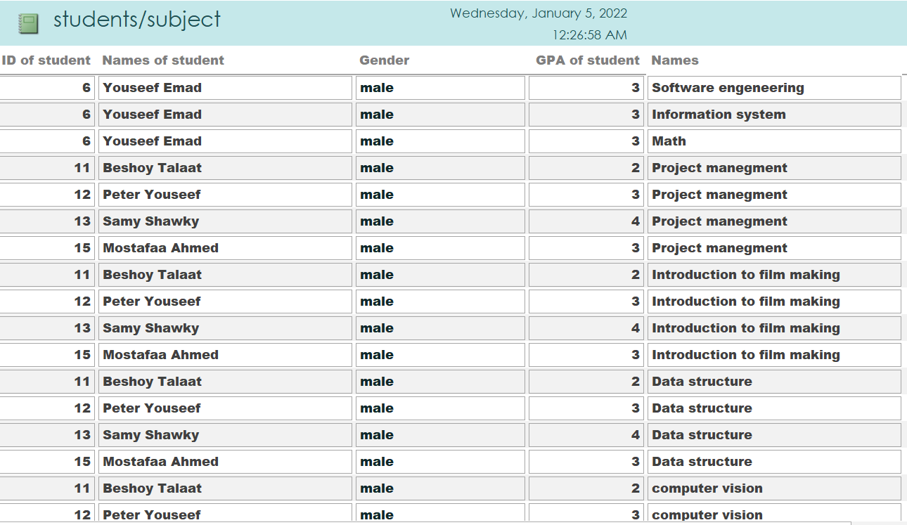
Report subject and students

Slide 27
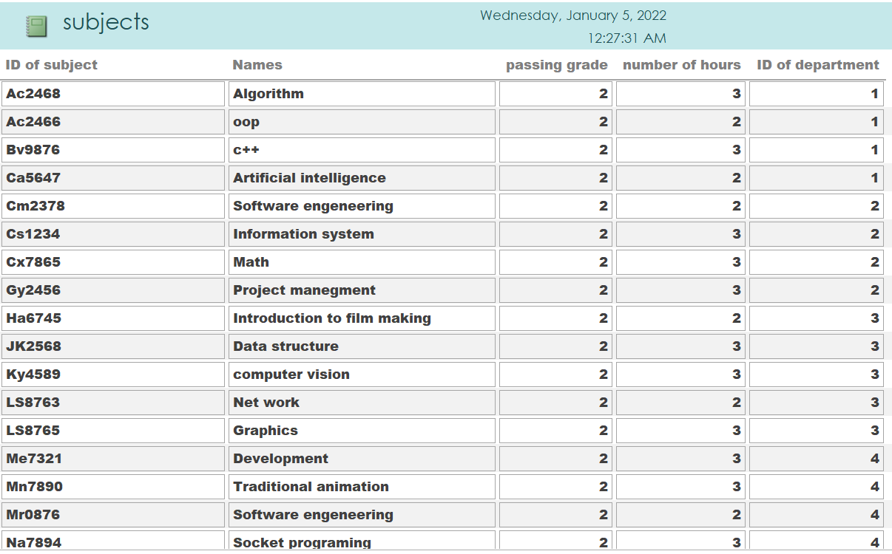
Report for subjects

Slide 28
Team
مريم جاب الله عزيز سعد
مريم ماهر زكرى
هيلانه لمعى اسكندر
هايدى عاطف زكريا قلدس

